Slide 1
CHAPTER 7
DECISION MAKING IN PROGRAMS

Slide 2
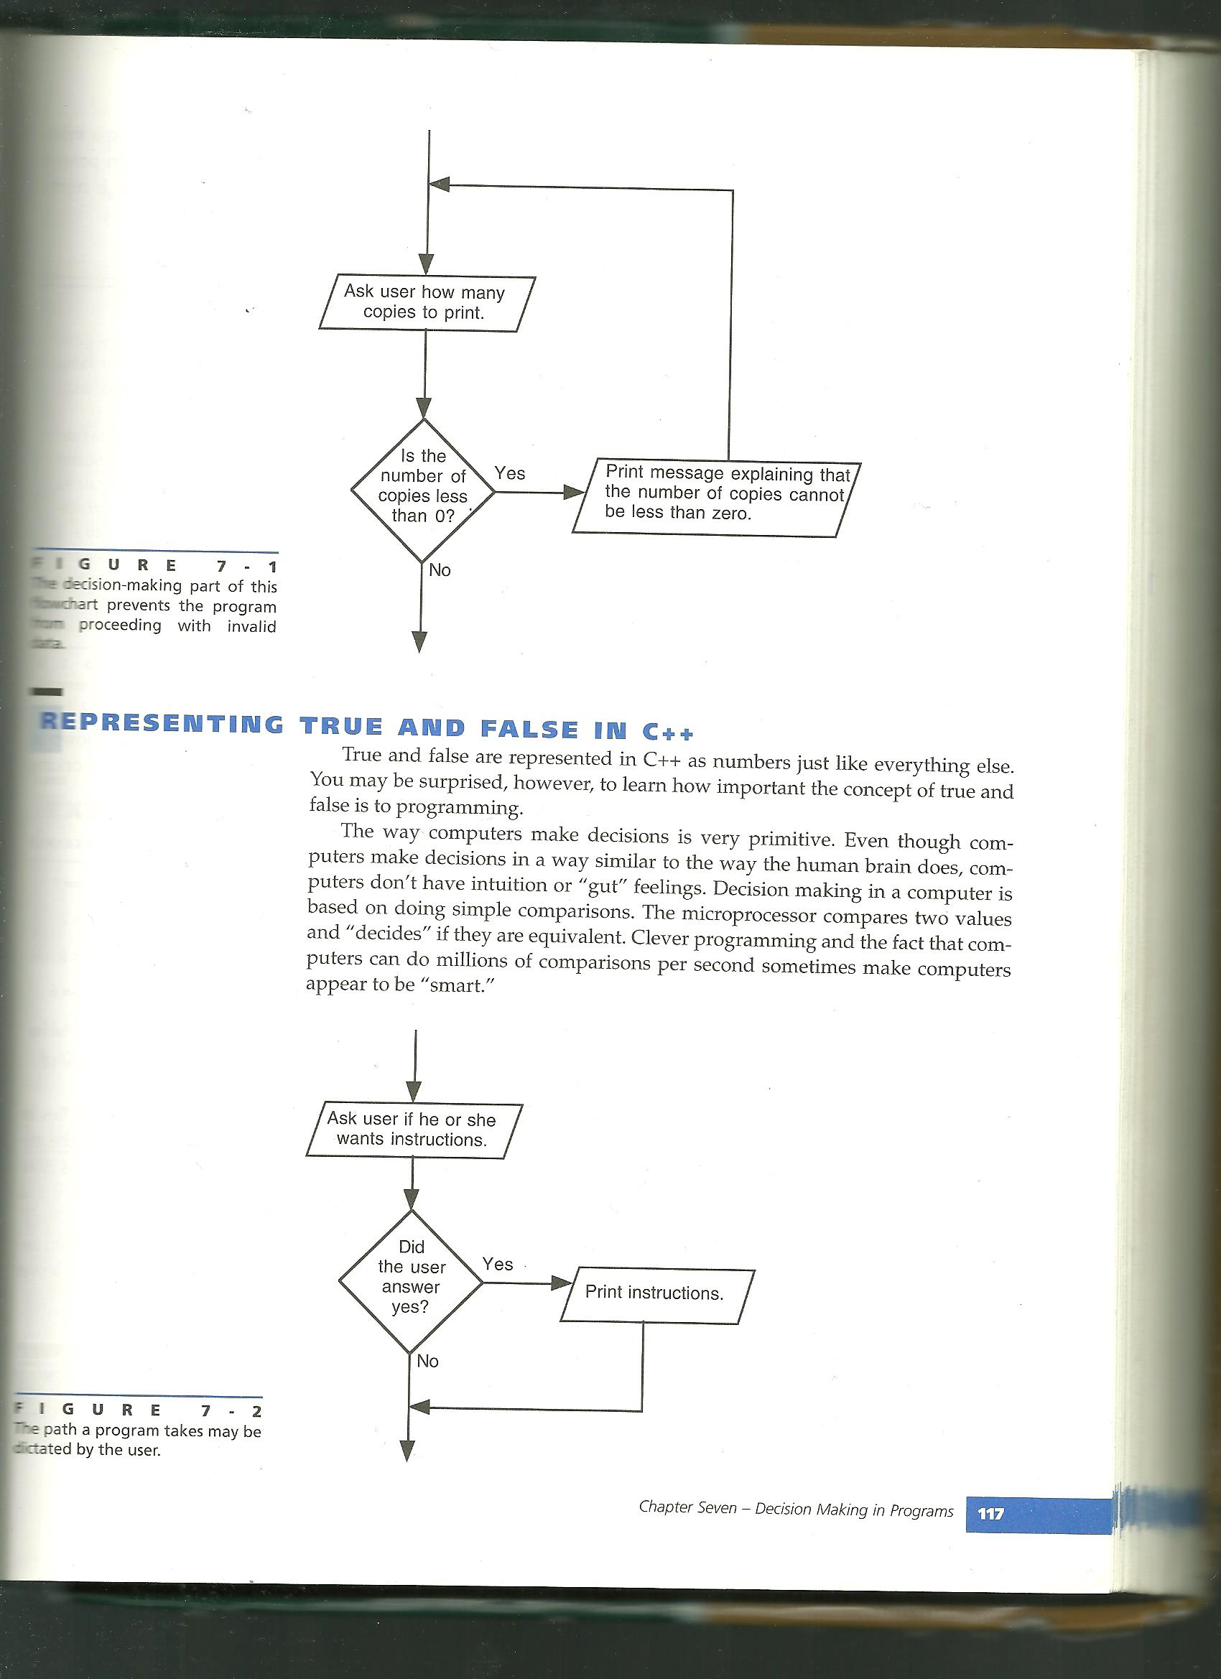
Decision Making
Computers use decision making as a process to drive the way a program runs.
Ex.
Fuzzy Logic – A system that allows more than simply true or false. Ex. If 1 = true, and 0 = false, 0.9 = probably true.

Slide 3
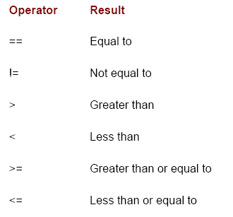
Relational Operators
Ex. High low game
if (guess == num)
{
cout<<“correct”;
}
if (guess > num)
{
cout<<“too high”;
}
if (guess < num)
{
cout<<“too low”;
}

Slide 4
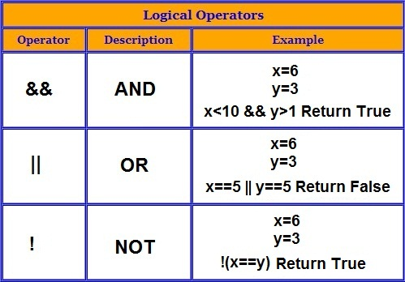
Logical Operators

Slide 5
Selection structures:
So far you have used sequence structure, that flow through the program line by line.
Selection structures control the flow of a program based on decisions.
Ex.
-If structures aka. one-way selection structures
-If Else structures aka. two-way selection structures
-Switch structures
Note: Remember that the = and the == operators are different. == is used for testing values, while = is used to assign the value of a variable.

Slide 6
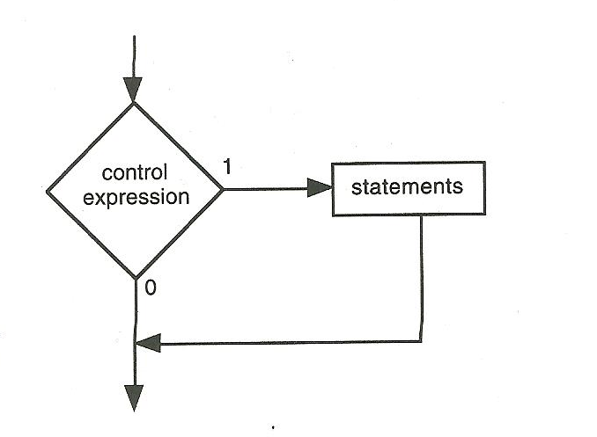
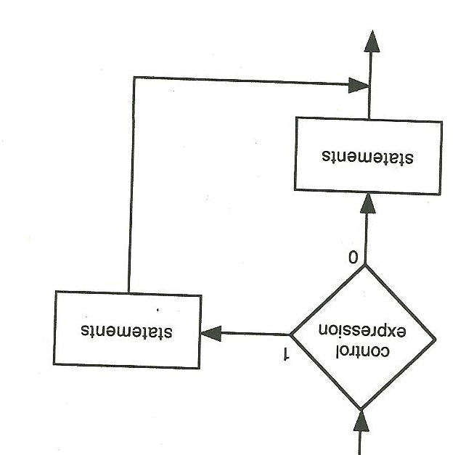
If structure
Else/If structure
if (population >= 171,322) //the part in parenthesis
{ is called the control
cout<<“that’s a big city”; expression
}
else
{
cout<<“that’s a midget city”;
}

Slide 7
Nested if test - An if test within an if test
If (size => 9)
{
If (air_pressure >= 9 && air_pressure <= 13)
{
cout<<“that’s a nice basketball”;
}
}

Slide 8
The Switch Structure
cin>>shipping_method;
switch(shipping_method)
{
case 1: //basically “if 1 is entered”
shipping_cost = 5.00;
break; //break causes the switch
case 2: statement to end
shipping_cost = 7.50;
break;
default: //default executes if nothing
shipping_cost =9.00; else matches
break;
}
Note: can also say case “carrier pigeon”: for string entry

Slide 9
Key terms:
control expression
fuzzy logic
if structure
if/else structure
logical operators
menu
nested
one-way selection structure
relational operators
selection structures
sequence structures
switch structure
two-way selection structure

